Slide 1
Subarray vs Substring vs Subsequence
Subarray: A subarray is a contiguous sequence of elements within an array.
Ex. A = {4, 3, 4} Subarrays: {}, {4}, {3}, {4, 3}, {3, 4}, {4, 3, 4}
Substring: A substring is exactly the same thing as a subarray but in the context of strings.
Ex. S = “brb” Substrings: “”, “b”, “r”, “br”, “rb”, “brb”
Subsequence: A subsequence is a sequence that can be derived from another sequence by deleting some or no elements without changing the order of the remaining elements.
Ex. <B, R, B> Subsequences: <>, <B>, <R>, <B, R>, <R, B>, <B, B>, <B, R, B>

Slide 2
Maximum Subarray Sum
Given an array of integers, find the maximum sum of values in a contiguous, nonempty subarray.
Ex. A = [-2, 1, -3, 4, -1, 2, 1, -5, 4]

Slide 3
Maximum Subarray Sum
Given an array of integers, find the maximum sum of values in a contiguous, nonempty subarray.
Ex. A = [-2, 1, -3, 4, -1, 2, 1, -5, 4]
Algorithms?

Slide 4
Maximum Subarray Sum
Given an array of integers, find the maximum sum of values in a contiguous, nonempty subarray.
Ex. A = [-2, 1, -3, 4, -1, 2, 1, -5, 4]
Algorithms?
Brute Force: O(n^2) time O(1) space
Dynamic Programming: O(n) time O(n) space
Kadane’s Algorithm: O(n) time O(1) space

Slide 5
Maximum Subarray Sum
Given an array of integers A[1..n], find the maximum sum of values in a contiguous, nonempty subarray.
Subproblem:
C[i] := The maximum sum obtainable from a subarray terminating at position i of the given array A[1..n]
Recursive Definition:
C[i] = max(A[i], A[i] + C[i – 1]) for i > 1
C[1] = A[1]

Slide 6
Maximum Subarray Sum
Given an array of integers A[1..n], find the maximum sum of values in a contiguous, nonempty subarray.
Subproblem:
C[i] := The maximum sum obtainable from a subarray terminating at position i of the given array A[1..n]
Recursive Definition:
C[i] = max(A[i], A[i] + C[i – 1]) for i > 1
C[1] = A[1]
Ex.
A = [-2, 1, -3, 4, -1, 2, 1, -5, 4]
C = [-2, 1, -2, 4, 3, 5, 6, 1, 5]

Slide 7
Longest Common Subsequence
Given two sequences A[1..m], B[1..n], find the longest subsequence present in the two sequences.
Ex. A = “ABCBDAB” B = “BDCABA”

Slide 8
Longest Common Subsequence
Given two sequences A[1..m], B[1..n], find the longest subsequence present in the two sequences.
Ex. A = “ABCBDAB” B = “BDCABA”
There are three distinct LCS: “BDAB”, “BCAB” and “BCBA”
Algorithms?

Slide 9
Longest Common Subsequence
Given two sequences A[1..m], B[1..n], find the longest subsequence present in the two sequences.
Ex. A = “ABCBDAB” B = “BDCABA”
There are three distinct LCS: “BDAB”, “BCAB” and “BCBA”
Algorithms?
Brute Force: O(max(m,n)*2^min(m,n)) time O(min(m,n)) space
Dynamic Programming: O(mn) time O(mn) space
Improved Dynamic Programming: O(mn) time O(min(m,n)) space

Slide 10
Longest Common Subsequence
Given two sequences A[1..m], B[1..n], find the longest subsequence presents in the two sequences.
Ex. A = “ABCBDAB” B = “BDCABA”
There are three distinct LCS: “BDAB”, “BCAB” and “BCBA”
Subproblem:
C[i, j] := The longest common subsequence of A[1..i], B[1..j].
Recursive Definition:
C[i,j] = 1+C[i-1, j-1] if A[i] == B[j] else max(C[i-1, j], C[i, j-1])
C[0, j] = 0 and C[i, 0] = 0

Slide 11
Longest Common Substring
Given two sequences A[1..m], B[1..n], find the longest substring presents in the two sequences.
Ex. A = “ABCDCAC” B = “BDCAB”

Slide 12
Longest Common Substring
Given two sequences A[1..m], B[1..n], find the longest substring presents in the two sequences.
Ex. A = “ABCDCAC” B = “BDCAB”
Algorithms?

Slide 13
Longest Common Substring
Given two sequences A[1..m], B[1..n], find the longest substring presents in the two sequences.
Ex. A = “ABCDCAC” B = “BDCAB”
Subproblem:
C[i, j] := The longest common substring suffix of A[1..i], B[1..j].
Recursive Definition:
C[i,j] = 1+C[i-1, j-1] if A[i] == B[j] else 0
C[0, j] = 0 and C[i, 0] = 0

Slide 14
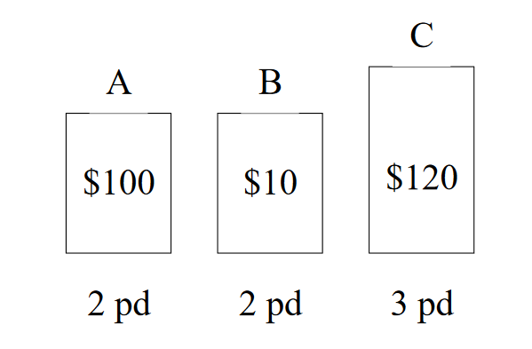
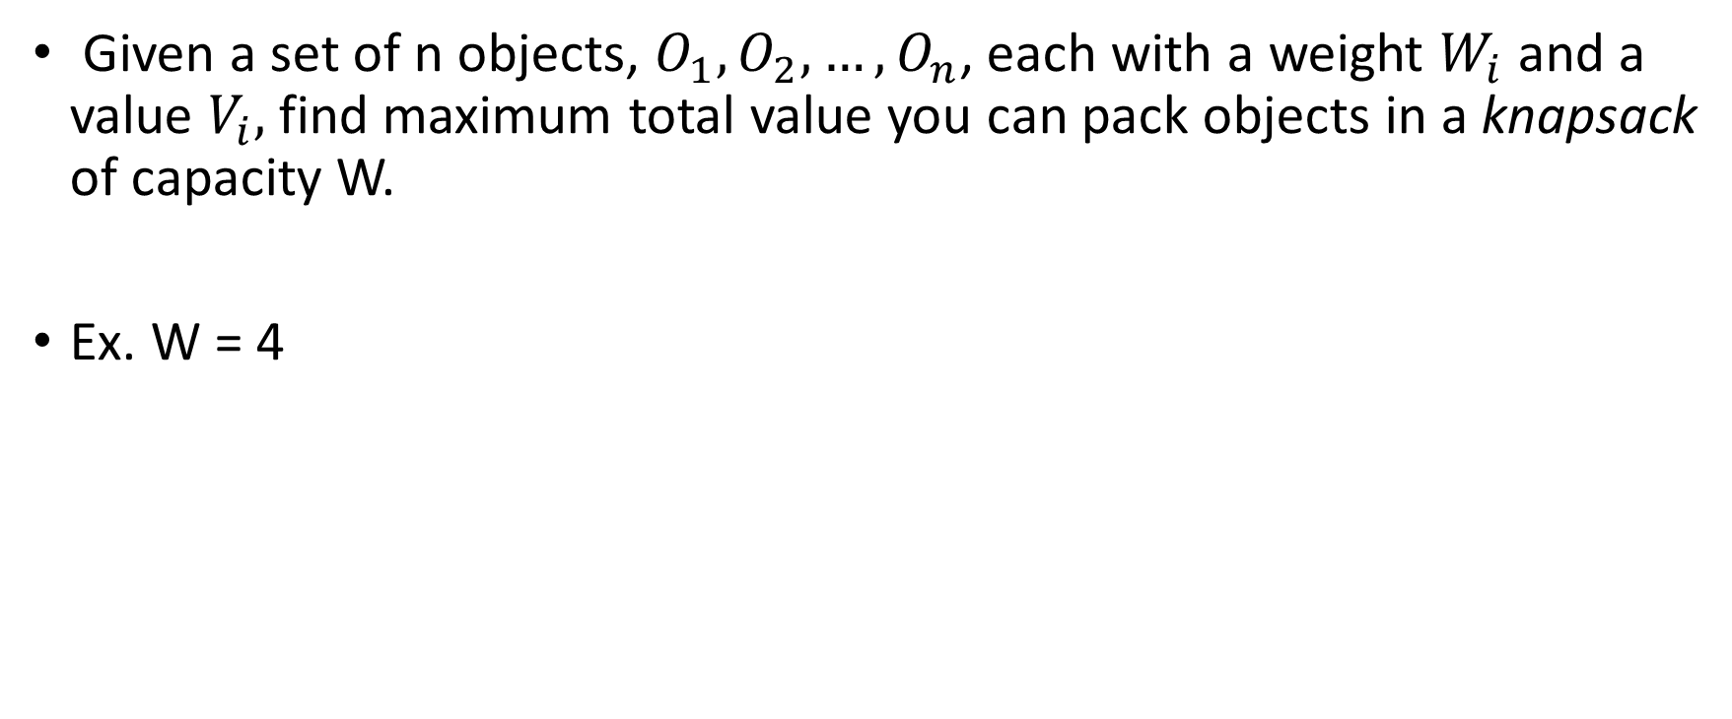
0-1 Knapsack
Given a set of n objects, $O_{1}, O_{2}, …, O_{n}$, each with a weight $W_{i}$ and a value $V_{i},$find maximum total value you can pack objects in a knapsack of capacity W.
Ex. W = 4

Slide 15
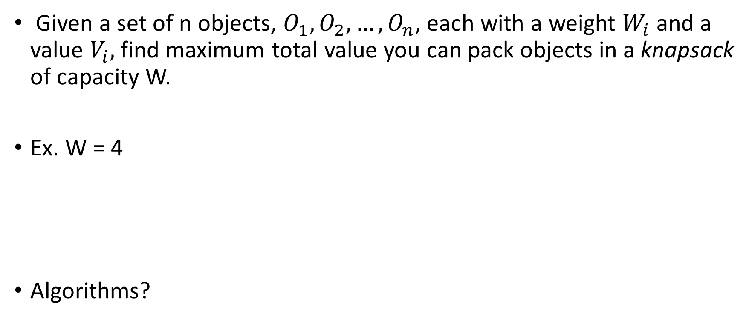
0-1 Knapsack
Given a set of n objects, $O_{1}, O_{2}, …, O_{n}$, each with a weight $W_{i}$ and a value $V_{i},$find maximum total value you can pack objects in a knapsack of capacity W.
Ex. W = 4
Algorithms?

Slide 16
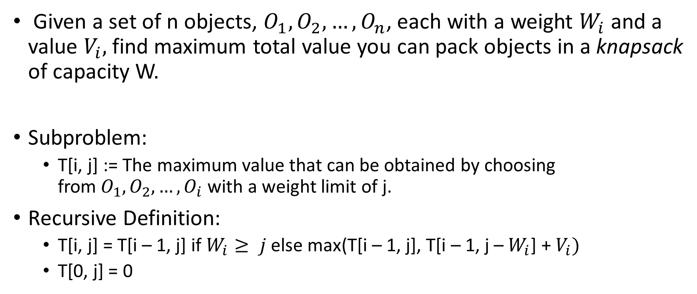
0-1 Knapsack
Given a set of n objects, $O_{1}, O_{2}, …, O_{n}$, each with a weight $W_{i}$ and a value $V_{i},$find maximum total value you can pack objects in a knapsack of capacity W.
Subproblem:
T[i, j] := The maximum value that can be obtained by choosing from$O_{1}, O_{2}, …, O_{i}$ with a weight limit of j.
Recursive Definition:
T[i, j] = T[i – 1, j] if $W_{i}≥ j$ else max(T[i – 1, j], T[i – 1, j – $W_{i}$] + $V_{i})$
T[0, j] = 0

Slide 17
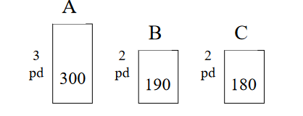
0-1 Knapsack
Given a set of n objects, $O_{1}, O_{2}, …, O_{n}$, each with a weight $W_{i}$ and a value $V_{i},$find maximum total value you can pack objects in a knapsack of capacity W.
Ex. W = 4

Slide 18
0-1 Knapsack
Given a set of n objects, $O_{1}, O_{2}, …, O_{n}$, each with a weight $W_{i}$ and a value $V_{i},$find maximum total value you can pack objects in a knapsack of capacity W.
Ex. W = 4

Slide 19
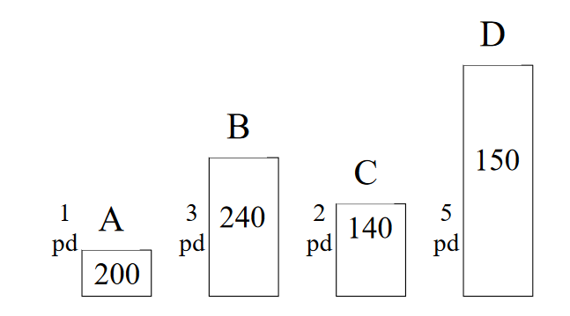
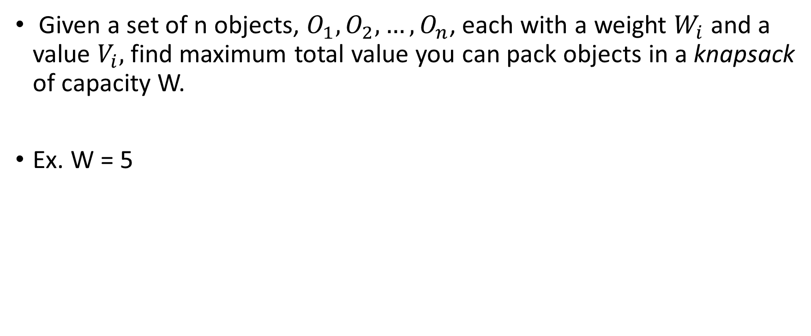
0-1 Knapsack
Given a set of n objects, $O_{1}, O_{2}, …, O_{n}$, each with a weight $W_{i}$ and a value $V_{i},$find maximum total value you can pack objects in a knapsack of capacity W.
Ex. W = 5

